Slide 1
Table 1. Summary of individuals examined and staining results
No. | Age | Sex | COHb(%) | cause of death | Orange | Colliquatte | Contraction B |  |  |  | Postmortem Interval | Remaining GC %
 |  |  |  |  |  |  | R | S-L | S-T | R
A-1 | 10 | F | 73.3 | CO; charcol | + | + | - | - | - | - | 36hours | ND
A-2 | 14 | F | 73.7 | CO; charcol | + | + | + | + | - | - | 30hours | ND
A-3 | 43 | M | 72.5 | CO; charcol | + | + | + | + | - | - | 33hours | ND
A-4 | 9 | F | 70 | CO; charcol | + | + | + | - | - | - | 2.5days | ND
A-5 | 43 | F | 74.2 | CO; charcol | + | + | - | - | - | - | 2.5days | ND
A-6 | 40 | M | 66.5 | CO; charcol | + | + | + | - | - | - | 2.5days | ND
A-7 | 25 | M | 72.8 | CO; charcol | + | + | + | + | - | - | 2.5days | ND
A-8 | 27 | F | 74.2 | CO; charcol | + | + | + | - | - | - | 2.5days | ND
A-9 | 28 | M | 71.3 | CO; charcol | + | + | + | - | - | - | 2.5days | ND
A-10 | 19 | F | 79.7 | CO; charcol | + | + | + | + | - | - | 2.5days | ND
A-11 | 43 | F | 66.5 | CO; charcol | + | + | + | - | - | - | 3.5days | ND
A-12 | 39 | M | 93.7 | CO; charcol | + | + | + | + | - | - | 25hours | 29.7
A-13 | 41 | F | 82.8 | CO; charcol | + | + | + | + | - | - | 25hours | 27.7
A-14 | 46 | M | 78.4 | CO; charcol | + | + | - | + | - | - | 4days | 29.7
A-15 | 40 | M | 80 | CO; charcol | + | + | - | + | - | - | 7days | 32.7
A-16 | 38 | M | 78.5 | CO; charcol | + | + | - | + | - | - | 7days | 21.4
A-17 | 26 | M | 87.1 | CO; charcol | + | + | - | + | - | - | 6days | 24.3
A-18 | 25 | F | 81.6 | CO; charcol | + | + | - | + | - | - | 6days | 26.8
A-19 | 55 | M | 84.1 | CO; charcol | + | + | - | + | - | - | 3days | 22.8
A-20 | 57 | F | 79.4 | CO; charcol | + | + | - | + | - | - | 3days | 33.7
B-1 | 43 | F | 79.5 | house fire | + | + | + | + | + | + | 30hours | 45.7
B-2 | 13 | F | 89.5 | house fire | + | + | + | + | - | + | 30hours | 44.2
B-3 | 16 | F | 83.5 | house fire | + | + | + | + | - | + | 30hours | 51.7
C-1 | 62 | F | 0 | fire; suicide | + | + | + | + | - | - | 30hours | 46
C-3 | 59 | M | 0 | fire; suicide | + | + | + | + | + | + | 24hours | 65
D-1 | 26 | F | 0 | hypothermia | + | + | + | + | + | + | 30hours | 56.3
CO; saturation of COHb, CO;charcol; suicidal CO poisoning, Orange; color changed cells, Colliquatte; cells with vacuoles, contraction B; contraction band, R; right ventricle, S-L, S-T; septum longitudinal or transverse, L; left ventricle, GC; granular cells in the cerebellum, ND; not determined

Slide 2
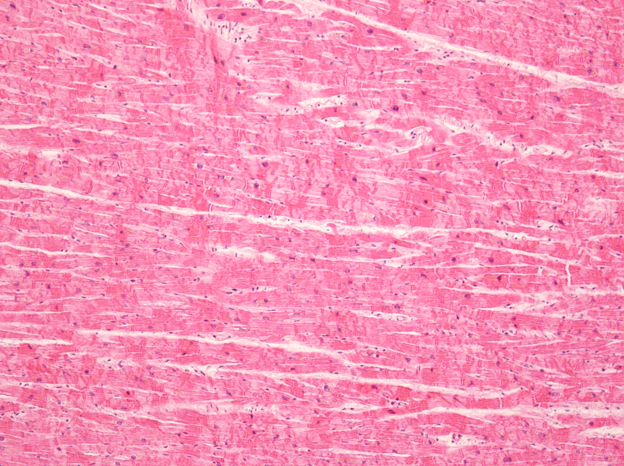
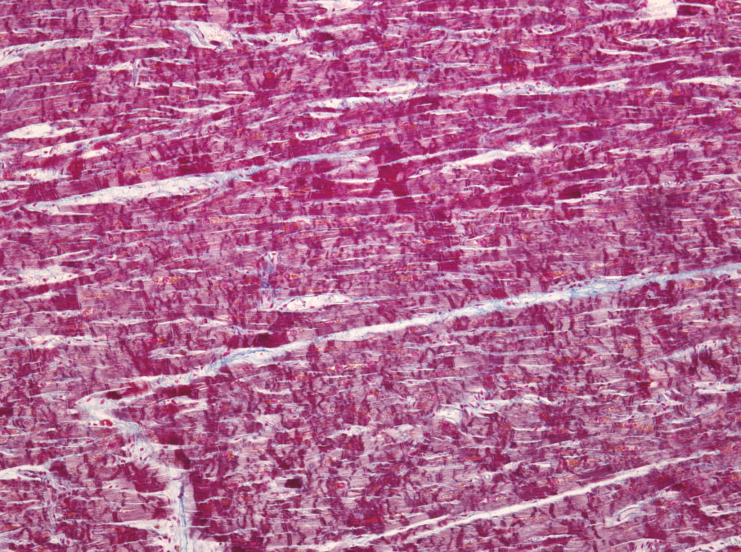
A
B
Figure 1. Contraction band detected in a 74 year old male who died due to suicidal house burning with severe thermal damage in the heart.
A large number of contraction band were detected by HE stain (A), and in the Azan
Staining (B) the color was not different from that from other individuals.

Slide 3
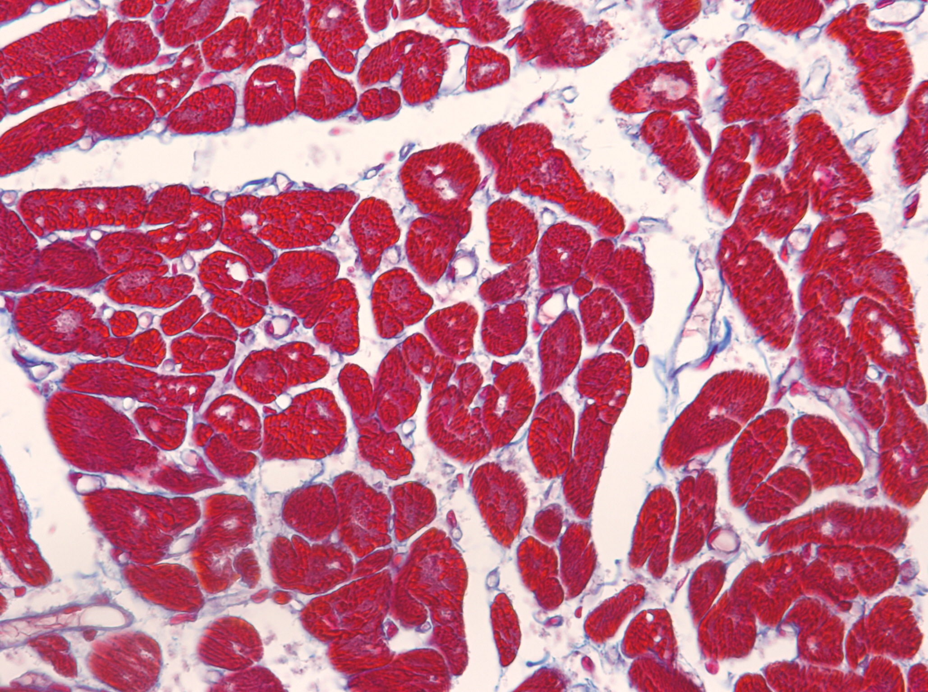
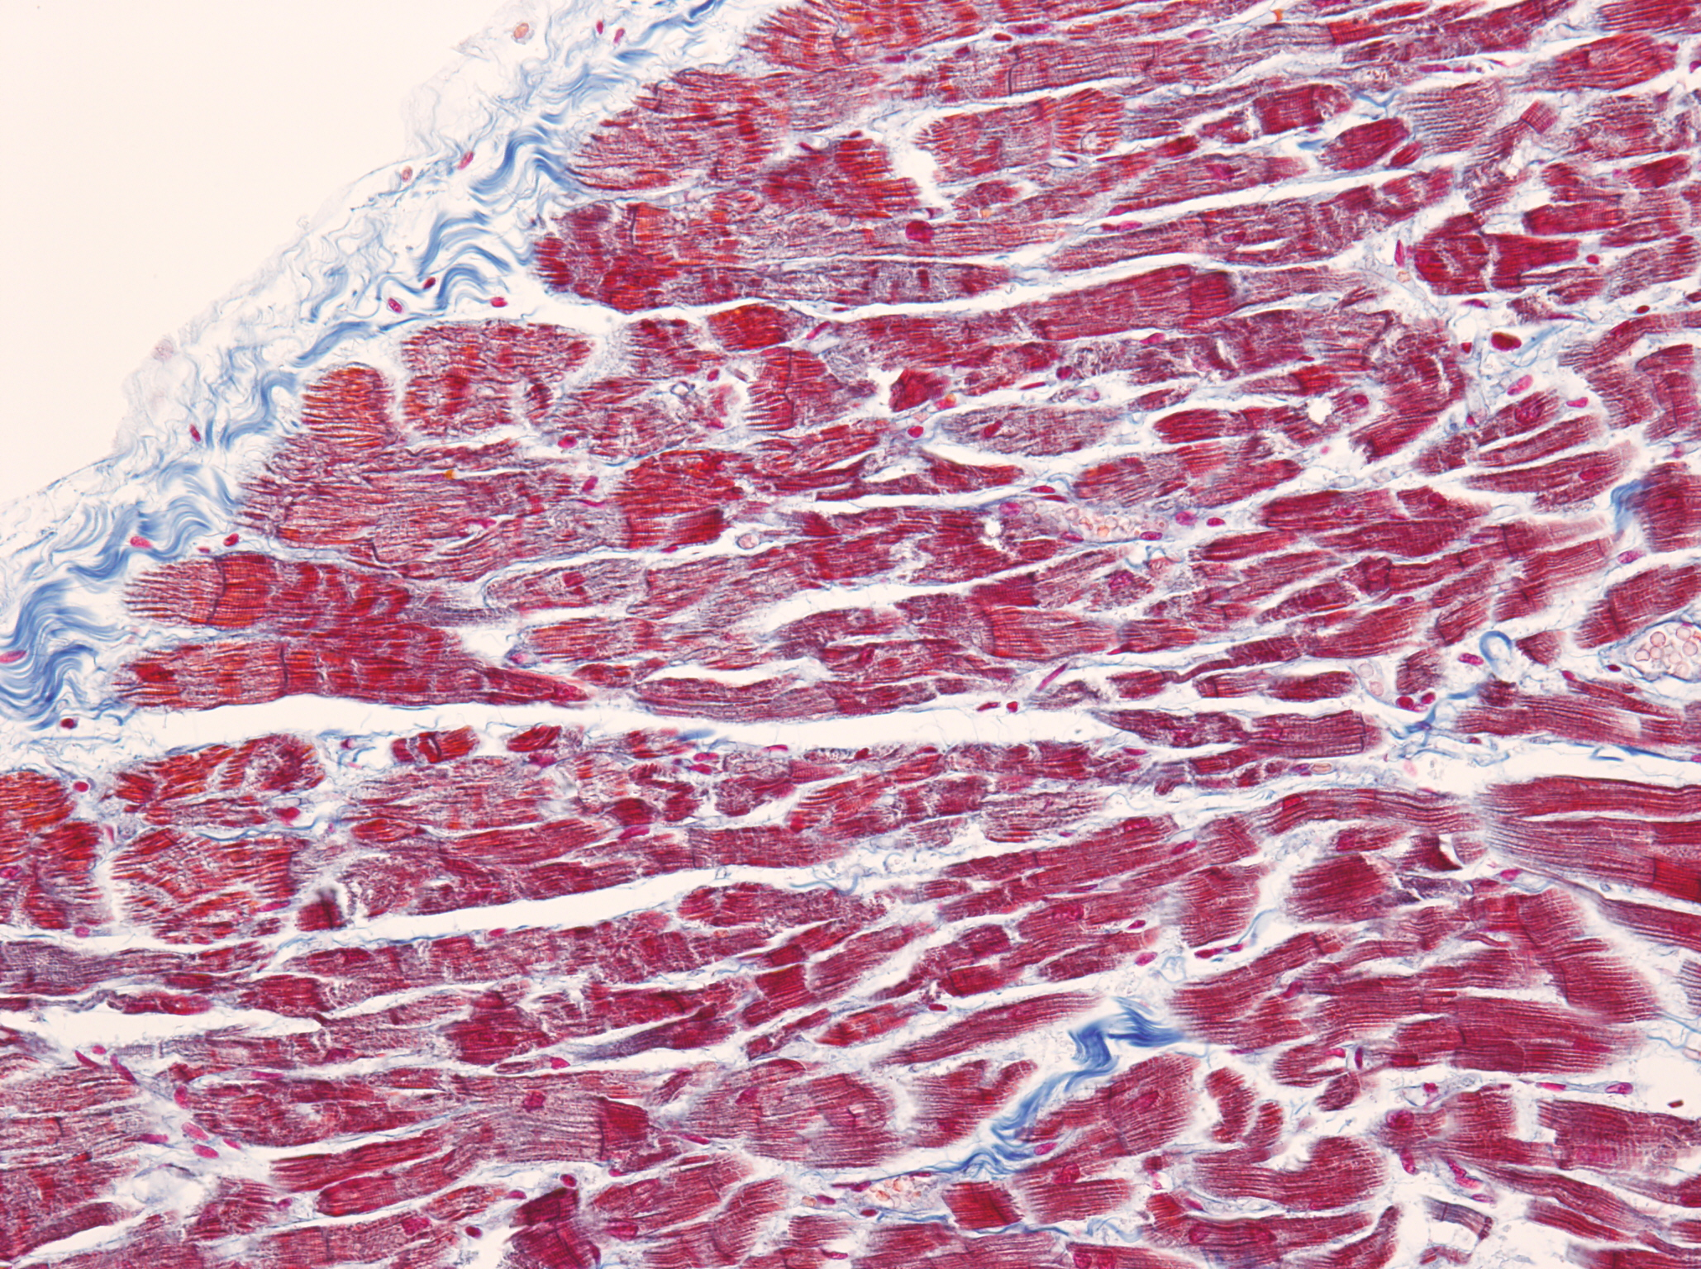
A
B
Figure 2. Hypoxic changes observed in the myocardium using Azan stain.
Azan stain showed orange color myocardial cells in the left ventricle (A) and
contraction bands and colliquative myocytolysis (B) were also recognized in the
right ventricle obtained from A-13 case who died carbon monoxide poisoning
using burning charcoal briquet.

Slide 4
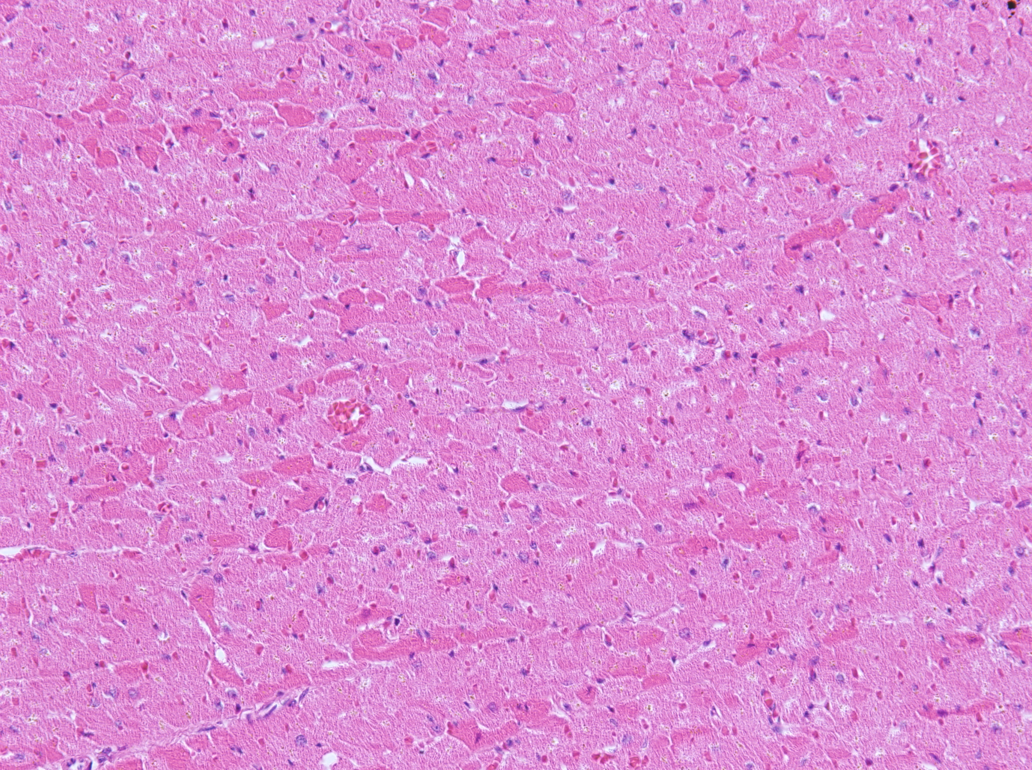
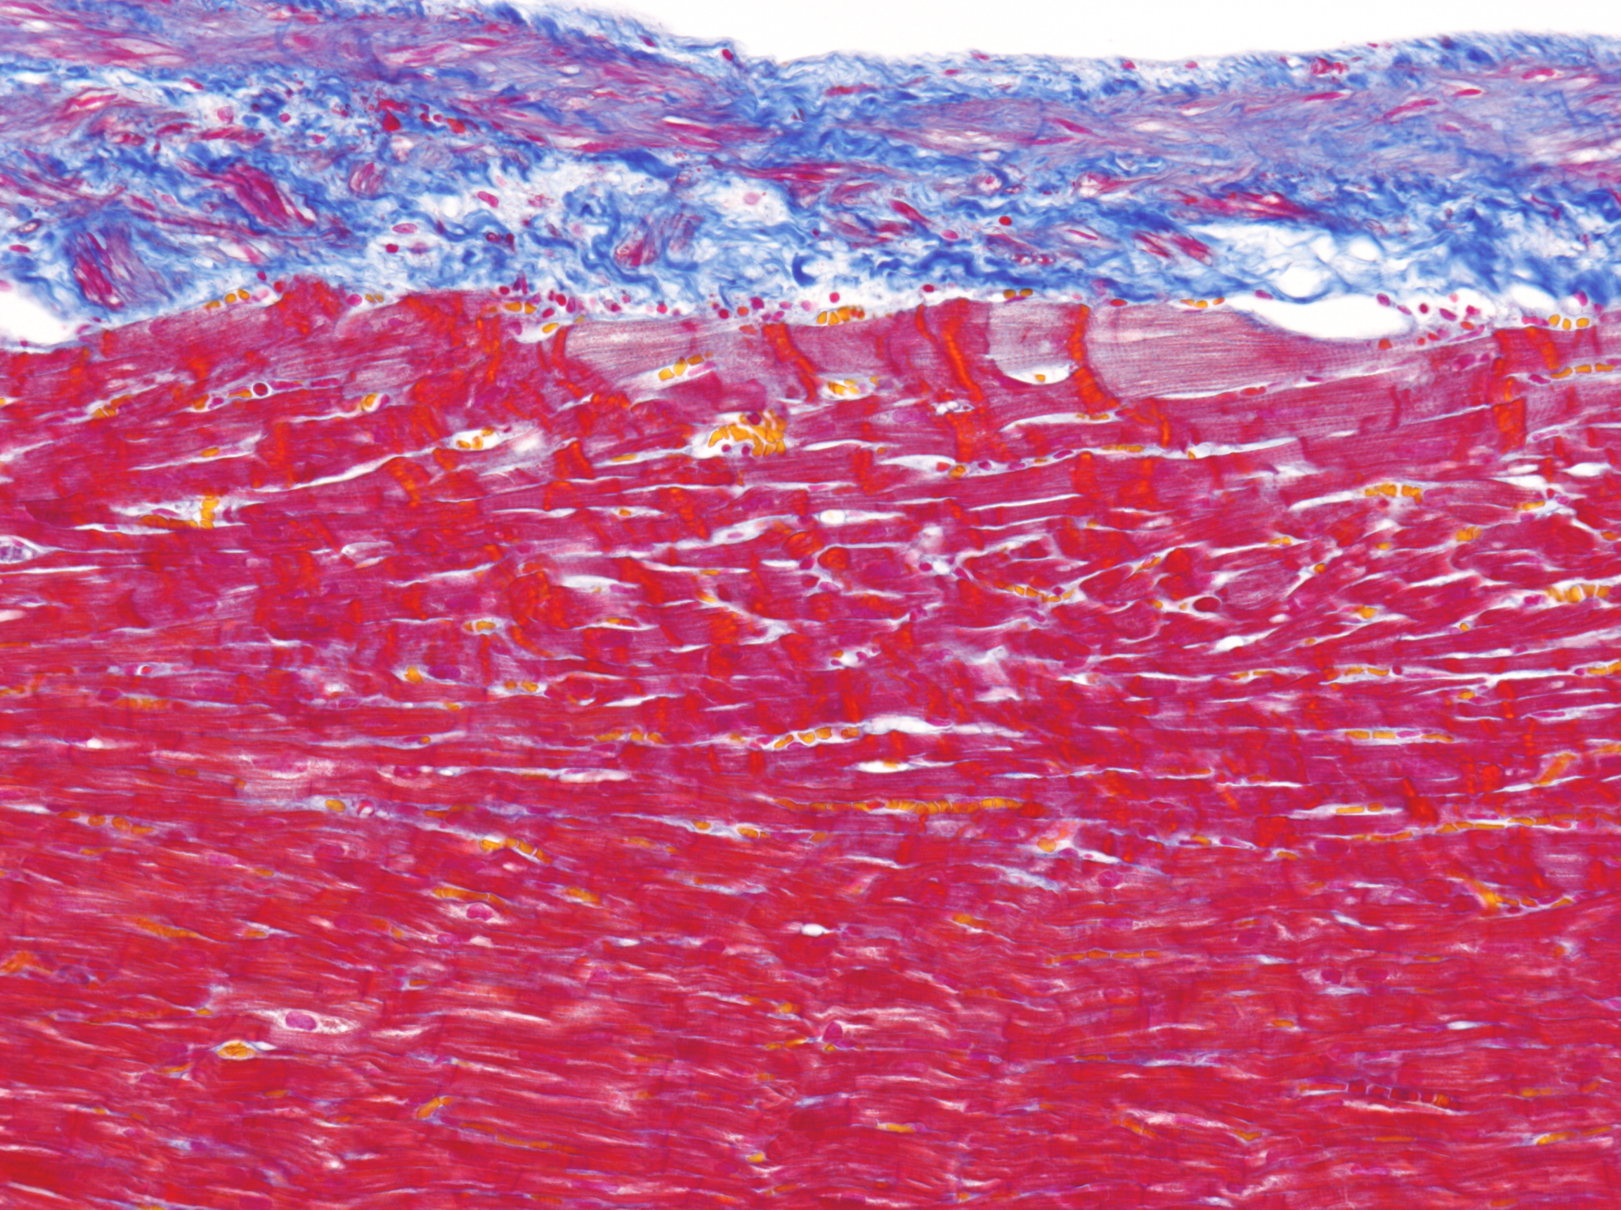
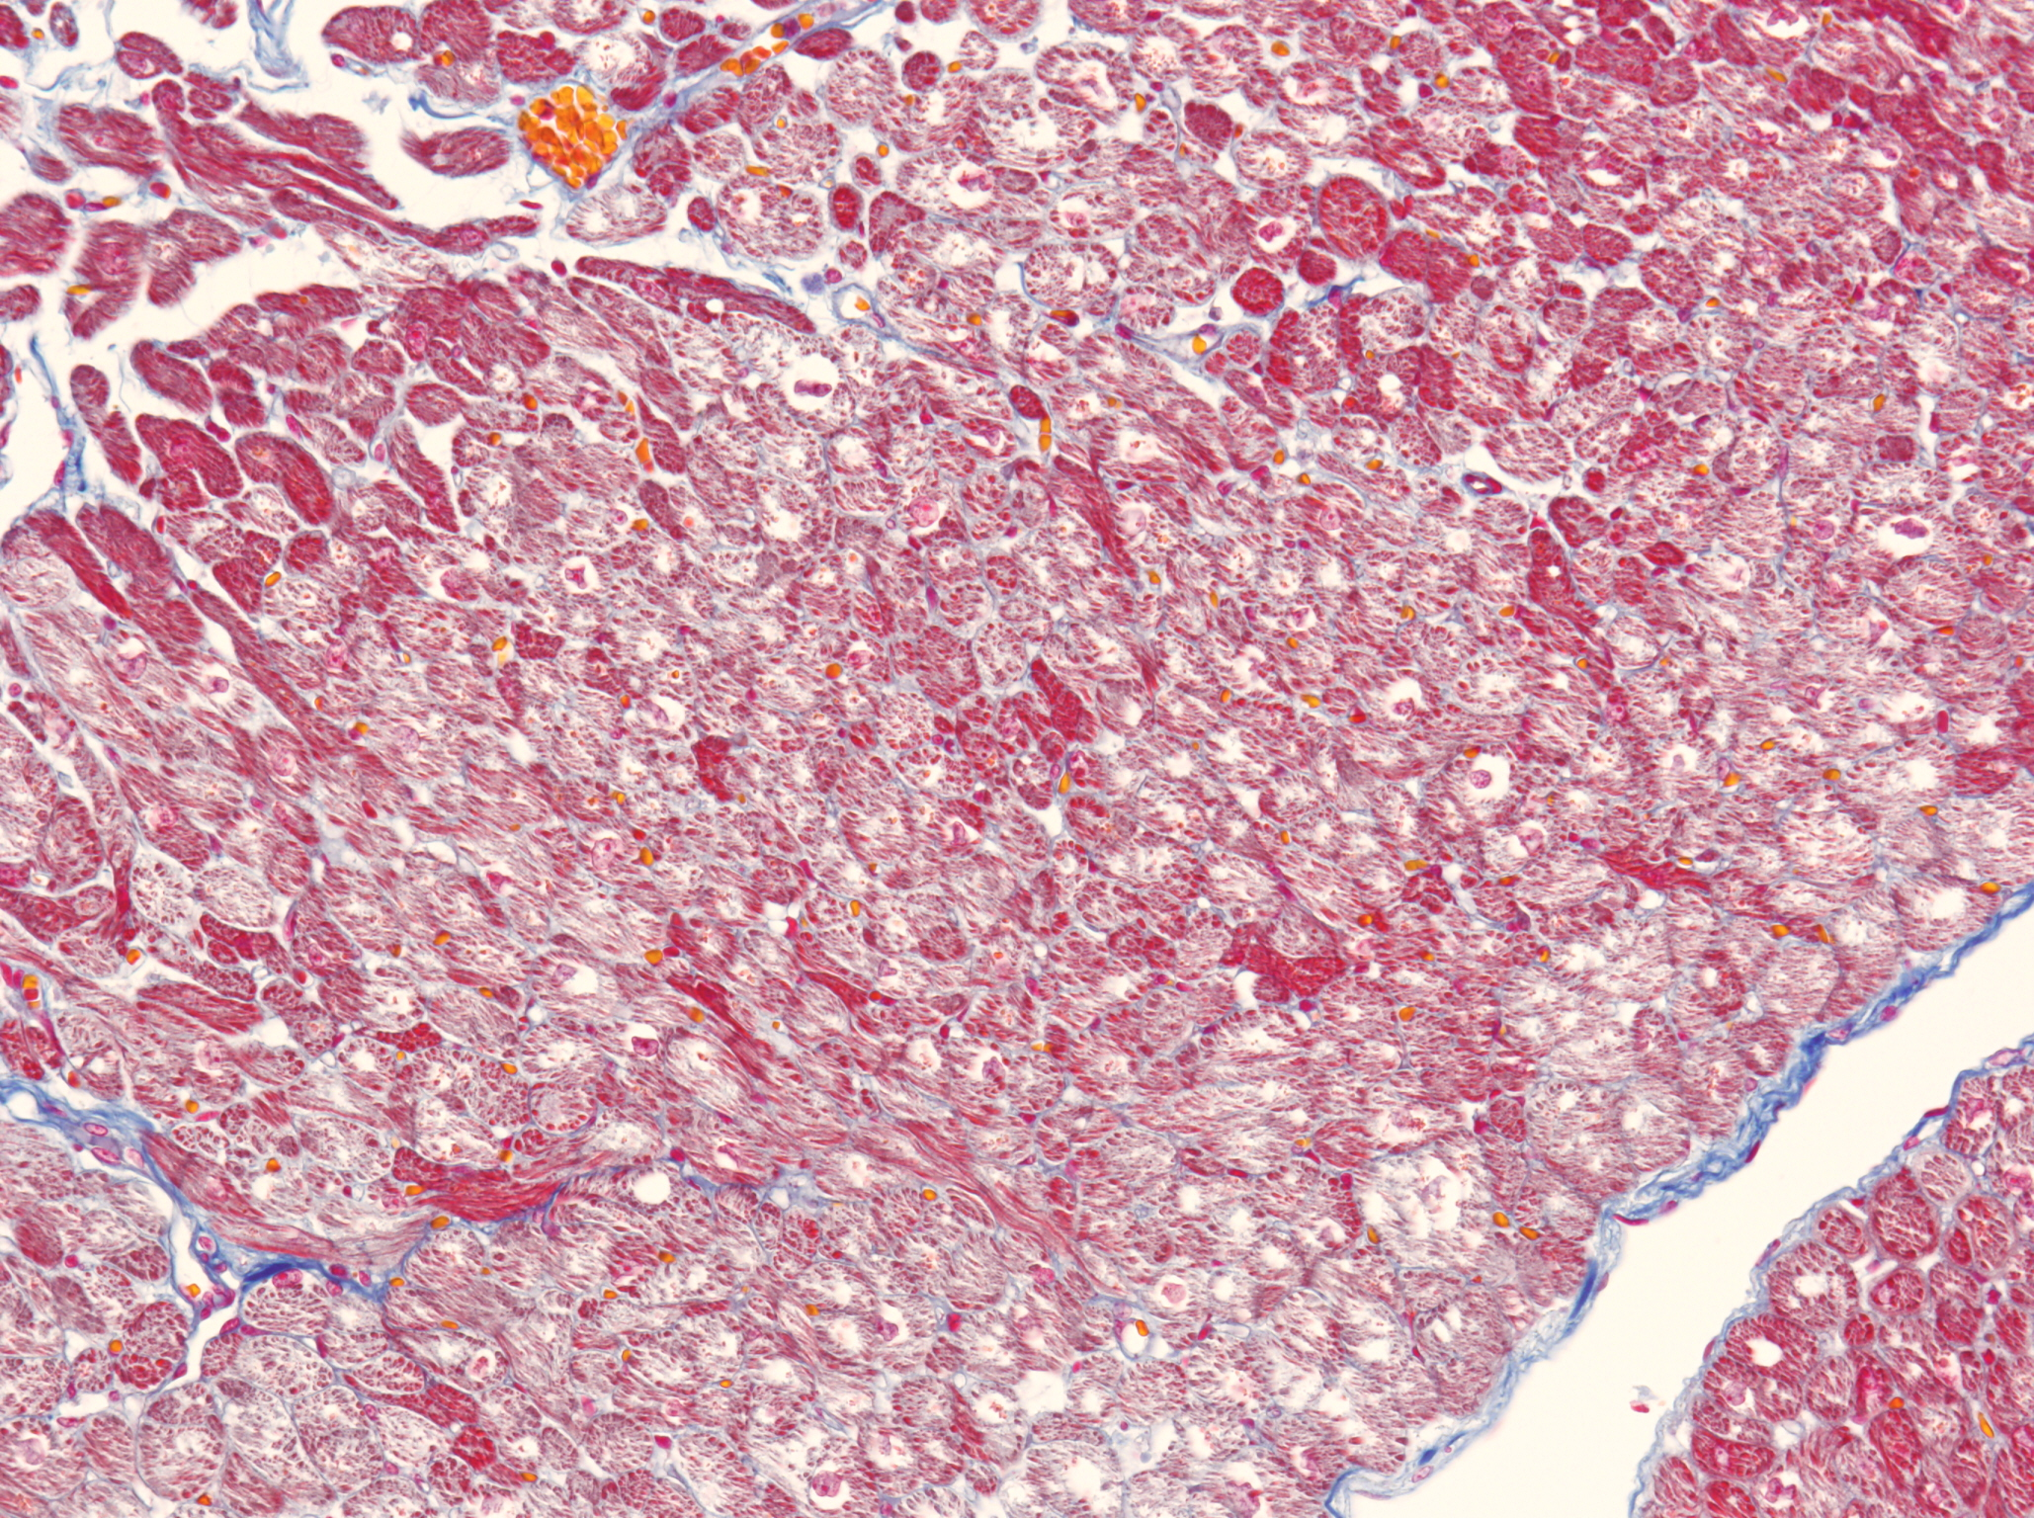
A
B
C
Figure 3. Cardiac tissue obtained from D-1 case who died due to hypothermia.
A: The adhered cardiac cells in hypothermic
death. The cardiac cells remarkably adhered
to each other and red colored cells are also
recognized. HE stain. × 100
B: The contraction bands were detected by Azan stain. ×200
C: The colliquative myocytolysis was detected by Azan stain. ×100

